Slide 1


First Four Days: Let's Be the Change that Makes Gray Great
Setting New Standards

Slide 2
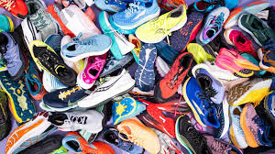
The Shoe game
Get with a partner; preferably with someone you are not so friendly with.
Tell each other what you teach and somethings you did this summer.
Now introduce your partner by name and what they teach or do and tell us what type of shoe they would be according to something they did this summer.

Slide 3
Community Agreements
Stay Engaged ​ | Don’t let your mind and heart check out​
​ Experience Discomfort / No Fixing ​ | Agree to experience discomfort so we can deal with issues that arise in an honest way. Neither you nor anyone else needs to be fixed​
​ Speak Your Truth ​ | Be honest about your thoughts, feelings and opinions. Say them in a way that is true for you using “I statements​
Expect and Accept Non-Closure​ | You will not reach closure in your understanding on a topic, idea or theme​
Listen For Understanding​ | Don’t listen to respond but to understand others​
Have Learning Courage​ | Engage and ask questions for the sake of learning​
​ Intent and Impact​ | Recognize that what we say may have an unintended impact, even though we may have positive intent. Own the impact.​
Stay Engaged ​ | Don’t let your mind and heart check out​
Table talk
Which one of the community agreements is resonating with you the most right now? Why?
Which one of the community agreements do you find yourself struggling with the most? Why/

Slide 4
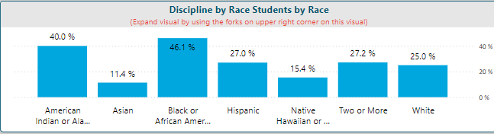
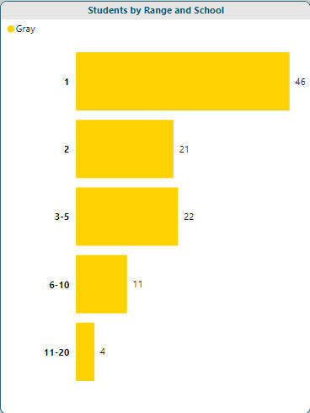
What Changes Need to be made?
We have a discipline disparity gap

Slide 5
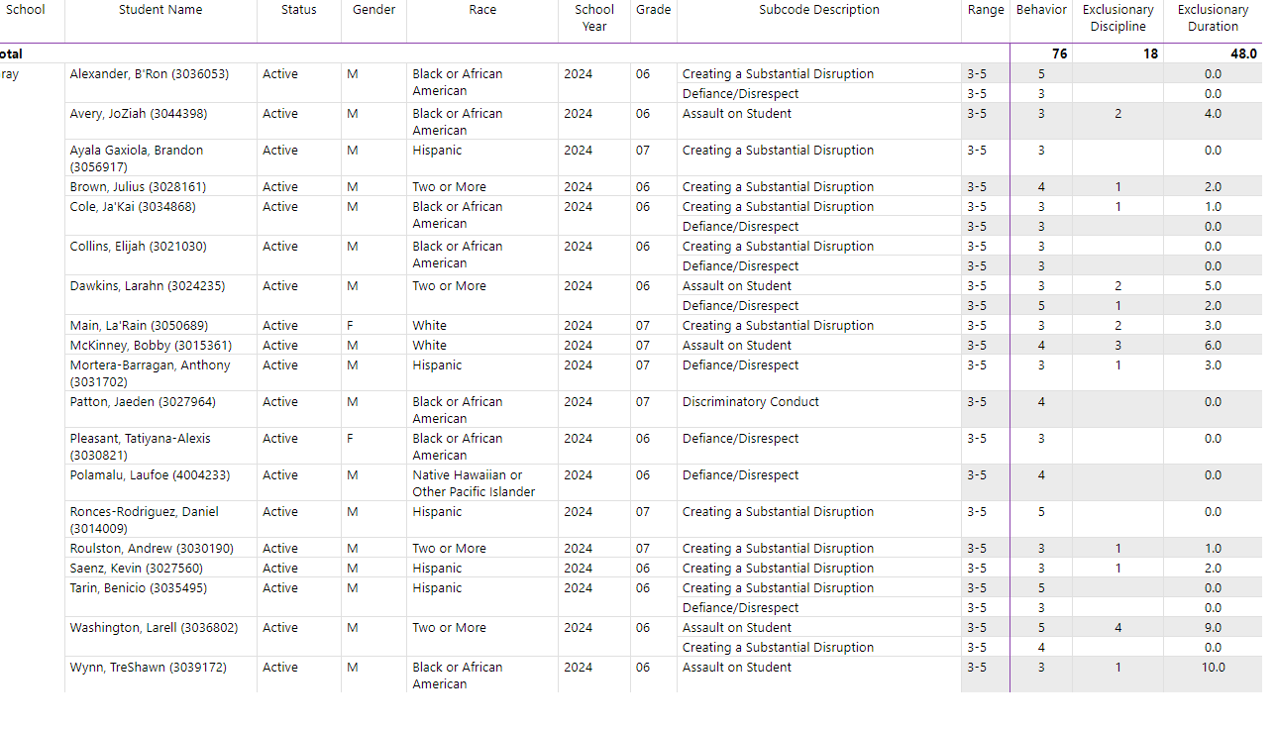
What changes needs to be made?

Slide 6
What changes need to be made
SBAC 2022-2023
SBAC 2023-2024
6th Grade
  ELA: 25%
  Math: 16%
7th Grade
  ELA: 35%
  Math: 19%
8th Grade
  ELA: 30%
  Math: 13%
Average ELA: 30%
Average Math: 16%
6th Grade
  ELA: 22%
  Math: 14%
7th Grade
  ELA: 20%
  Math: 13%
8th Grade
  ELA: 31%
  Math: 14%
Average ELA: 23%
Average Math: 18%

Slide 7
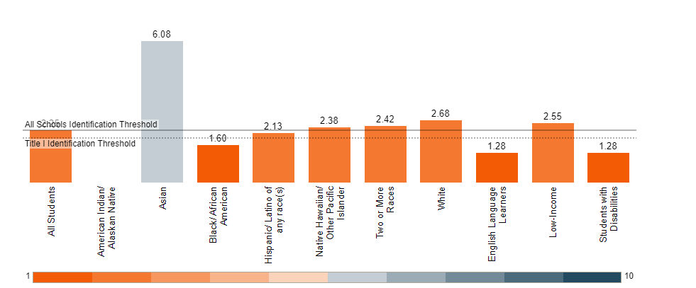
What changes need to be made

Slide 8
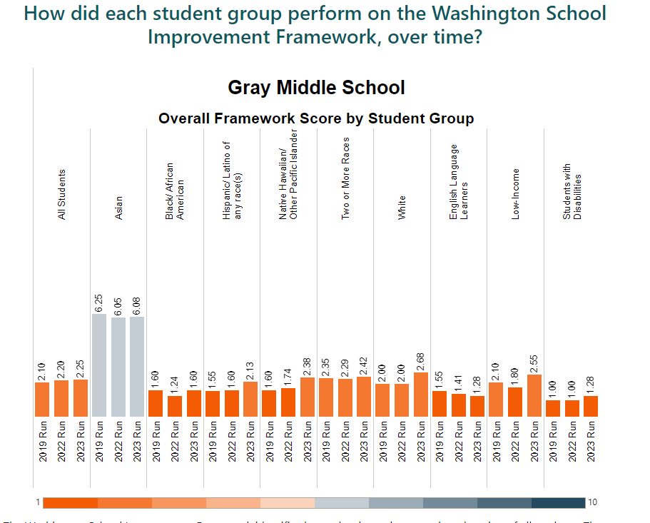
What changes need to be made

Slide 9
Gray Pilot 3 Themes

Slide 10
Community Agreements
Stay Engaged ​ | Don’t let your mind and heart check out​
​ Experience Discomfort / No Fixing ​ | Agree to experience discomfort so we can deal with issues that arise in an honest way. Neither you nor anyone else needs to be fixed​
​ Speak Your Truth ​ | Be honest about your thoughts, feelings and opinions. Say them in a way that is true for you using “I statements​
Expect and Accept Non-Closure​ | You will not reach closure in your understanding on a topic, idea or theme​
Listen For Understanding​ | Don’t listen to respond but to understand others​
Have Learning Courage​ | Engage and ask questions for the sake of learning​
​ Intent and Impact​ | Recognize that what we say may have an unintended impact, even though we may have positive intent. Own the impact.​
Stay Engaged ​ | Don’t let your mind and heart check out​
Table talk
Which one of the community agreements is resonating with you the most right now? Why?
Which one of the community agreements do you find yourself struggling with the most? Why/

Slide 11
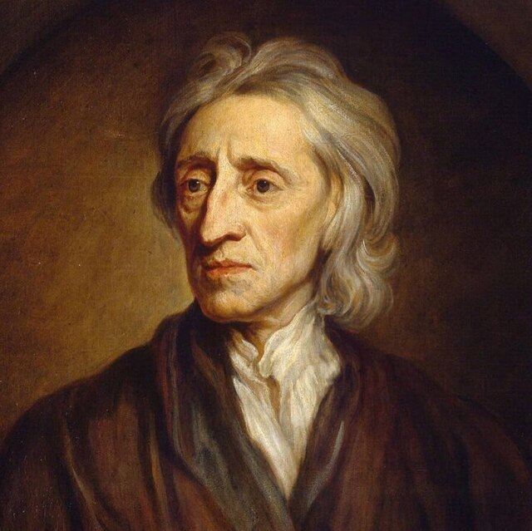
Tabula Rosa
noun
an absence of preconceived ideas or predetermined goals; a clean slate.
"the team did not have complete freedom and a tabula rosa from which to work“
*Originated from John Locke

Slide 12

Effort
a vigorous or determined attempt
strenuous physical or mental exertion.
the activities of a group of people with a common purpose.

Slide 13
Student’s effort Rubric
4 | I worked on the task until it was completed. I pushed myself to continue working on the task even when difficulties arose, or a solution was not immediately evident. I viewed difficulties that arose as opportunities to strengthen my understanding.
3 | I worked on the task until it was completed. I pushed myself to continue working on the task even when difficulties arose, or a solution was not immediately evident.
2 | I put some effort into the task, but I stooped working when difficulties arose.
1 | I put very little effort into the task.

Slide 14

Consistency
conformity in the application of something, typically that which is necessary for the sake of logic, accuracy, or fairness.
the achievement of a level of performance that does not vary greatly in quality over time.

Slide 15
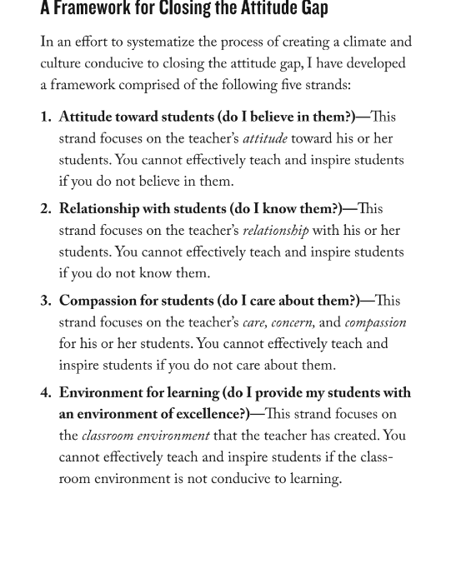

Slide 16

Are you ready to be the change?
Mirror Exercise

Slide 17
Mirror Reflection Questions
Do I believe in them?
Do I have a passion for teaching them?
Do I have a purpose for teaching them?
Do I treat teaching them as a mission?
Do I have a vision for what I expect of them?

Slide 18
Mirror Reflection Questions
Do I set incremental and long-term goals for them to achieve?
Do I plan each day thoroughly toward their success?
Do I see myself as a role model for them and always conduct myself as a professional?
Do I see myself as the number-one determinant of their success or failure?
Do I conduct daily self-reflection and self-assessments of my practice of teaching them?

Slide 19
MTSS Format for Gray’s changes
Instruction (Tier 1)
SEL (Tier 1)
Character Strong
Fireside Chats
PBIS
Honor Roll
100% Club
Critical Reading Comprehension
Culturally Responsive Instruction
Frequent Formative Assessment
Differentiated Instruction
Afterschool Tutoring
IXL supplemental instruction

Slide 20
MTSS Format for Gray’s changes
SEL (Tier 2)
Instruction (Tier 2)
Pilot Pride Award
100% Club (CI-CO, Attend, etc.)
Honor for 0.5 increase
Counselors’ support
Remedial small grouping
Intervention classes
Co-teach
Pull-out Push-in
Modified assignments

Slide 21
MTSS Format for Gray’s changes
Safety (Tier 1)
Classroom Management (Tier 1)
Staff Visibility
Administrative Team Visibility (ESP, CSO, & Admin)
Students Walking to the Right
No Students Gathering in Hallways
Regular Scheduled Emergency Drills
Bell to Bell Rigorous Instruction
Culturally Competent Practices
Consistent Learning Routines
Clear and Concise Expectation
Clear and Concise Consequences
Strategic Seating Chart
Restorative Justice Circles

Slide 22
MTSS Format for Gray’s changes
Safety (Tier 2)
Classroom Management (Tier 2)
Check-in Check-out
Safety Support Plans
No-contact Contracts
Parent/teacher/student conference
Administrative Involvement
Admin/parent/student conference
Modified Classroom Schedule
Behavior Support Plan
504 Referral

Slide 23
Gray MTSS Team
Administrators
Counselors
CSO
SPED Lead
Grade Level Leads
School Psych

Slide 24
September
9 | 10 | 11 | 12 | 13
16 | 17 | 18 | 19 | 20
23 | 24 | 25 | 26 | 27
30 | October
 | 1 | 2 | 3 | 4
7 | 8 | 9 | 10 | 11

