Slide 1

Leading with An Eye on Success For All Students

Slide 2
Leading Classrooms and Schools
With an Eye On Success
Learning Objectives for the Day
Learn how to move from punitive consequences to teachable moments
Learn the value of raising expectation vs adding more rules
Learn to create an instructional framework that ensure academic success for all students in the classroom
Learn to shift your leadership to an asset-based leadership approach
Learn to Live SEL as a foundation for success for all students

Slide 3

Powerful Quote to Start This Session
Schools do not rise to the level of their goals. They fall to the level of their systems.

Slide 4
Let’s Start by Implementing Systems that Will Rise to the Level of Our Goals
We must raise the level of our schoolwide expectation.
Students do not rise to rules; they rise to expectation
We cannot punish our way to a great school climate
Mean teachers have mean classes and mean principals have mean schools.

Slide 5
The Tale of Two Dollars
A Tale of 2 Dollars
YouTube · AVID CenterOct 16, 2018

Slide 6

Truman Middle School
SEL Story
29% of Truman Students Feel They Do Not Belong
  Deep Dive SEL Curriculum
  Focus Fireside Chat
  Name Tags
31% of Truman Students Do Not Feel Good About Themselves
  Focused Fireside Chat (My Story)
  Deep Dive SEL Curriculum
  Edge Coaching

Slide 7
We Decided That Character Strong Was the Foundation of Our School Support Plan
Building Staff Capacity to Support Each Other
  Optional SEL Staff Fridays
    Email
    Character Dare
  Tuesdays Staff Character Strong SEL
  Created a Master Schedule That Provided Students With SEL Lessons Four Morning a Week

Slide 8

We Can’t Wait to get Back to School Celebration
All Staff Present and Visible in Hallways
Expectation Stations Rotation
Greeting Signs Welcoming Students Back
Positive Vibes All Around
Rember Your First Day Teaching; Bring Your New Teacher Passion
Music Playing (Shake-it-off and Happy)

Slide 9

The results from believing in our SEL plan!!!
https://www.youtube.com/watch?app=desktop&feature=shared&v=O28W8cQfOcA

Slide 10

Ensuring Success for
All in The Classroom
The umbrella
Culturally Responsive and Relevant instruction
Music
Renaming people and places in a story
Strategic group (collaborative learning)

Slide 11
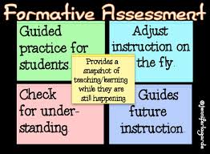
Frequent Formative Assessment
Hattie effect size
There are so many strategies to consider
Bullseye
Knowledge meter
Exit tickets
Short quizzes
Five finger meter

Slide 12
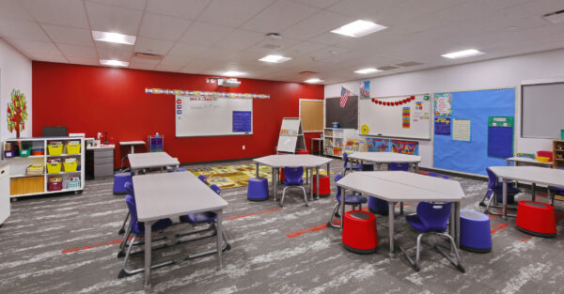

Now It’s Time to Open The Toolbox
Differentiated Instruction is the core of equity in the classroom.
This is where we meet groups of students with different needs at their access point.
Let’s talk about differentiated instruction!!!!

Slide 13

Why Use A Strength-Based Approach
Strengths-based educational models represent a return to basic educational principles that emphasize the positive aspects of student effort and achievement, as well as human strengths.
The strength-based approach is characterized by “efforts to label what is right” within people.
Strengths-based models embody a student-centered form of education with the primary goal of transforming students into confident, efficacious, lifelong learners whose work is infused with a sense of purpose (Anderson, 2000).

Slide 14

Asset-Based Approach Changes
Asset Based Leaders Focuses On Existing Capacity and Recourses.
Asset Based Leaders View the Community as Valuable Contributors
Asset Based Leaders Maximize and Recycles.
Asset Based Leaders are Proactive.
Asset Based Leaders See Community as Experts.
(Mein, 2018)
Truman New Family Engagement Center

Slide 15

Showing Teachers,
The Value of Asset Based
Better Understanding of The Whole Child
Collaborative Relationship with Parents/Guardian
Parental Ally regarding Behavior and Academic Participation
Best Method to Move Fence-Rider on the Right-Side of the Fence

Slide 16

Major Strategic Leadership Moves
Revamping conferences format from student-led to asset-based approach
Building PD days focus on asset-based and strength-based approach
Implementation of regular asset-based phone calls
Creation of an asset-based team

Slide 17
Consider
Stout’s Way, LLC To Support Your School Vision & Mission
You can contact me at:
stout.edu.consult@gmail.com
stouta1@spu.edu
Cell:253-444-7263

Slide 18
